Slide 1
Naïve Bayes
Session 11-12

Slide 2
Learning Outcome
LO 1: Explain the fundamental of machine learning concept
LO 2: Interpret the distribution of dataset using regression method
LO 3: Experiment classification and clustering algorithm from given dataset

Slide 3
Outline
Introduction
Bayes Classifier

Slide 4
Introduction

Slide 5
Introduction
Naïve Bayes is a classification technique based on Bayes’ Theorem with an independence assumption among predictors
a Naive Bayes classifier assumes that the presence of a particular feature in a class is unrelated to the presence of any other feature.

Slide 6
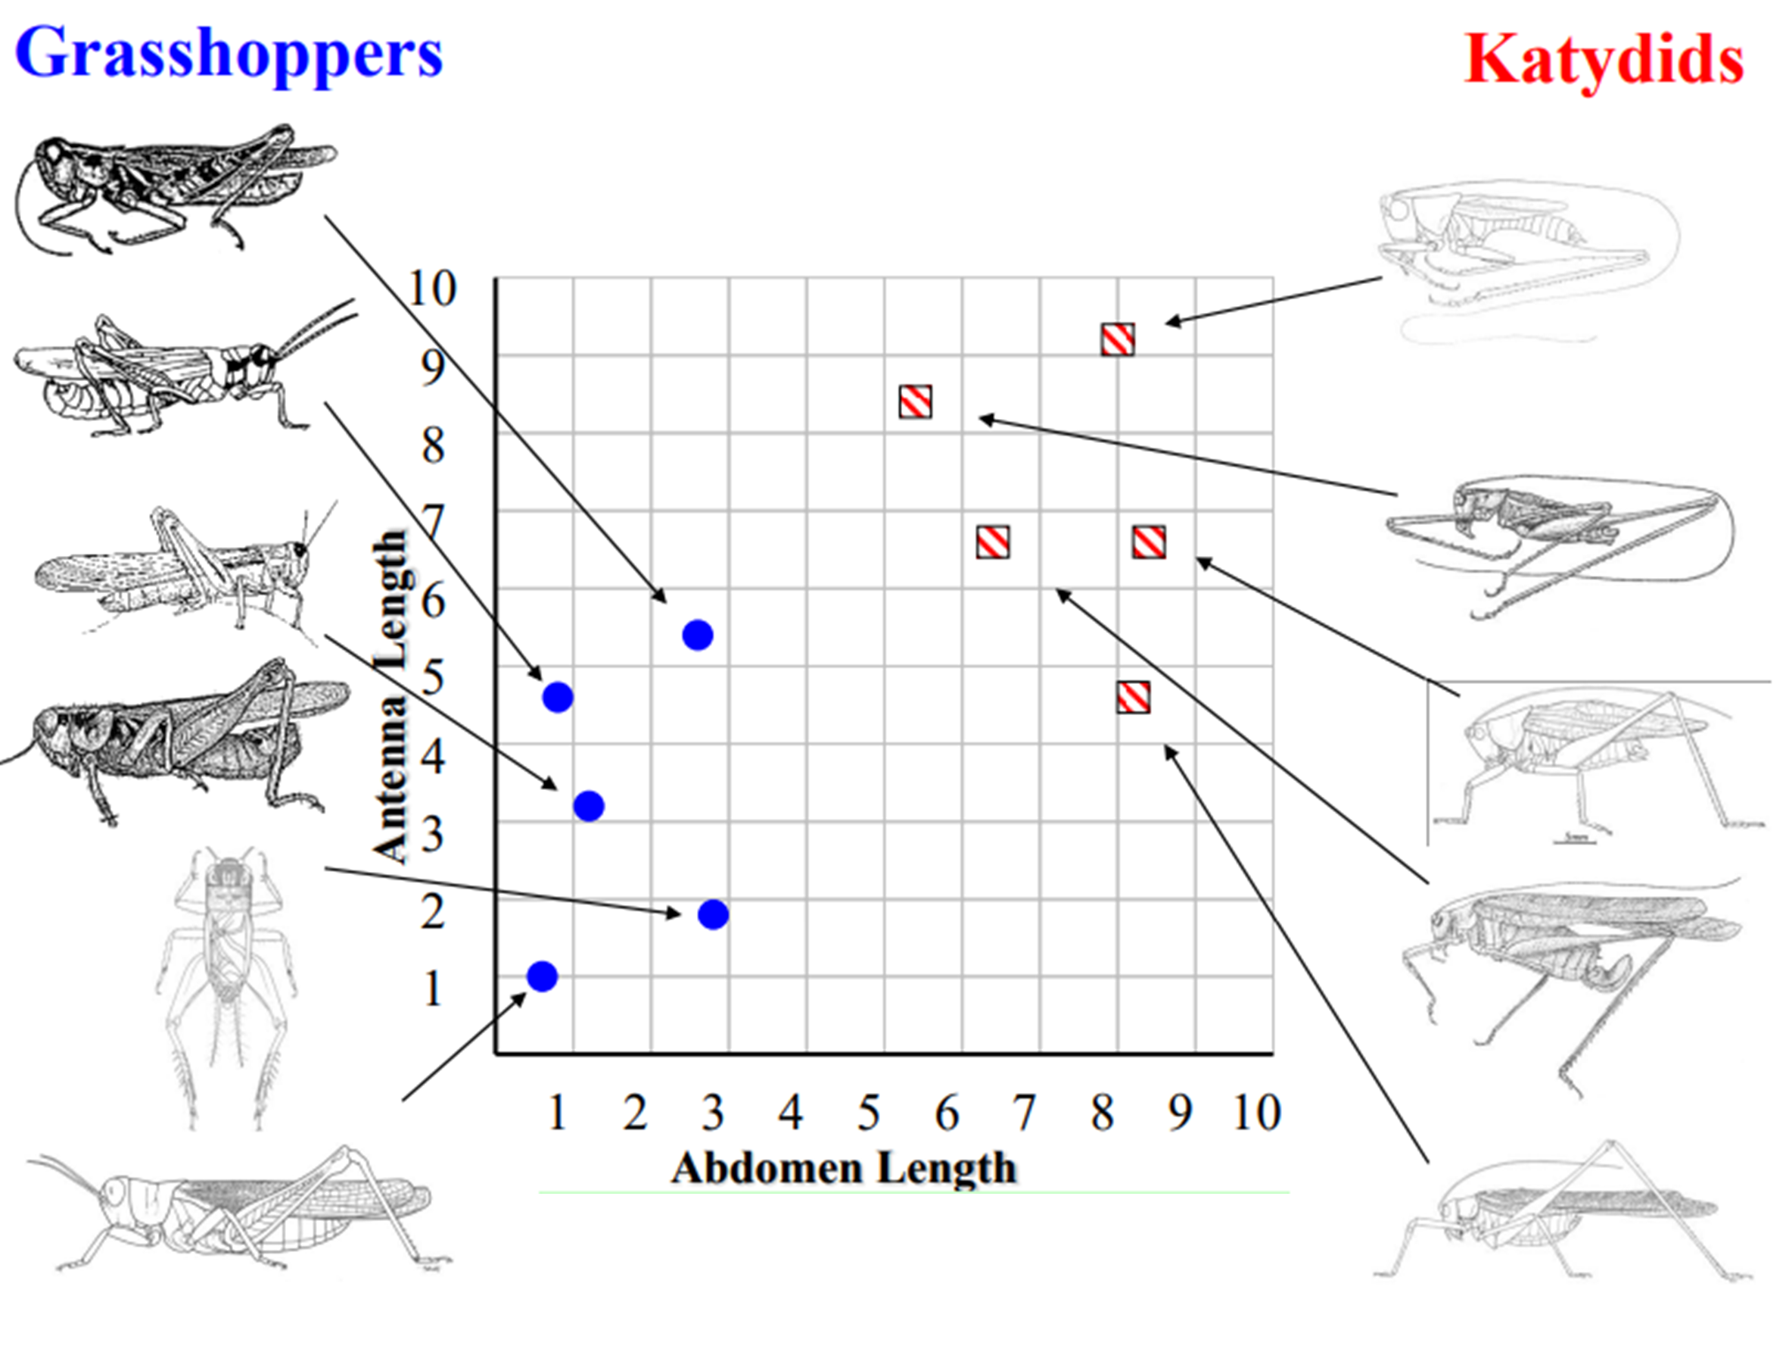
Introduction
Assume we have more Data from the images

Slide 7
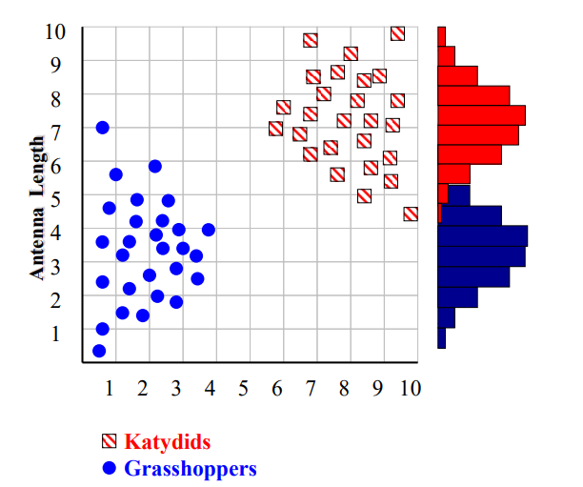
Introduction
With a lot of data, we can build a histogram. Let us just build one for “Antenna Length” for now

Slide 8
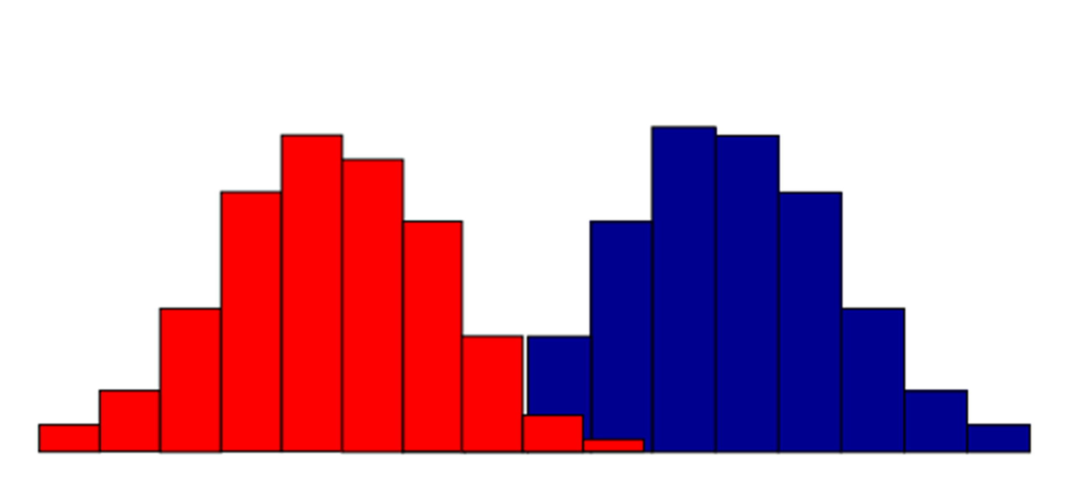
Introduction
We can leave the histograms as they are, or we can summarize them with two normal distributions.

Slide 9
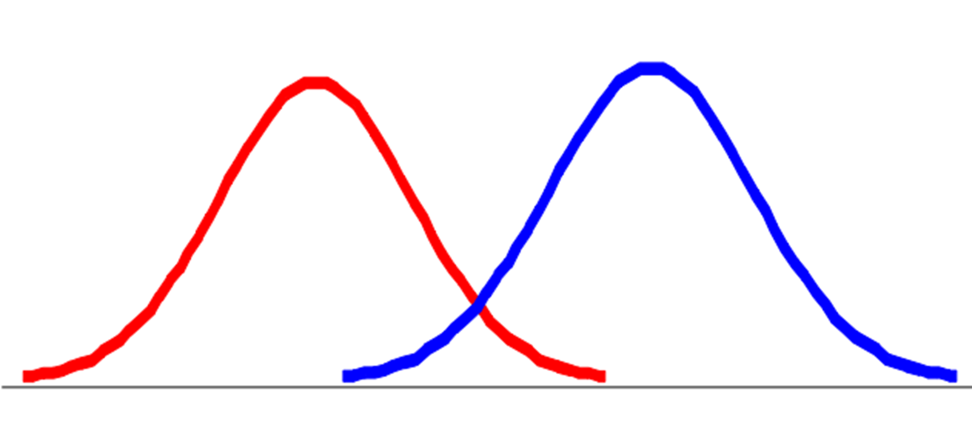
Introduction
Let us use two normal distributions for ease of visualization

Slide 10
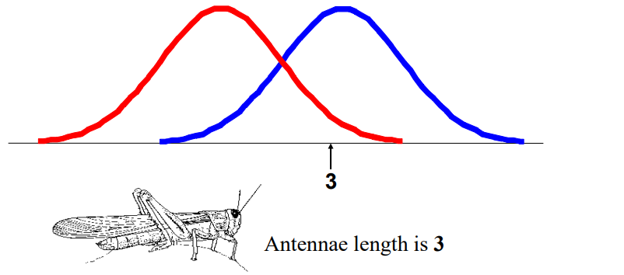
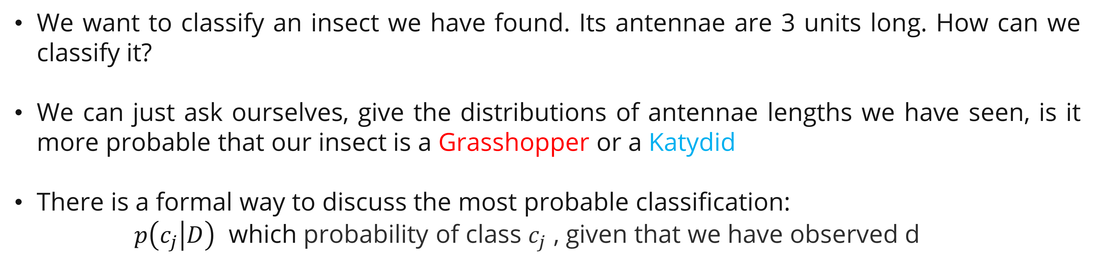
Introduction
We want to classify an insect we have found. Its antennae are 3 units long. How can we classify it?
We can just ask ourselves, give the distributions of antennae lengths we have seen, is it more probable that our insect is a Grasshopper or a Katydid
There is a formal way to discuss the most probable classification:
$p\left(c_{j} | D\right)$ which probability of class $c_{j}$ , given that we have observed d

Slide 11
Bayes Classifier

Slide 12
Bayes Classifier
That was a visual intuition for a simple case of the Bayes classifier, also called:
Idiot Bayes
Naïve Bayes
Simple Bayes
The basic idea of Naïve Bayes: Find out the probability of the previously unseen instance belonging to each class, then simply pick the most probable class.

Slide 13
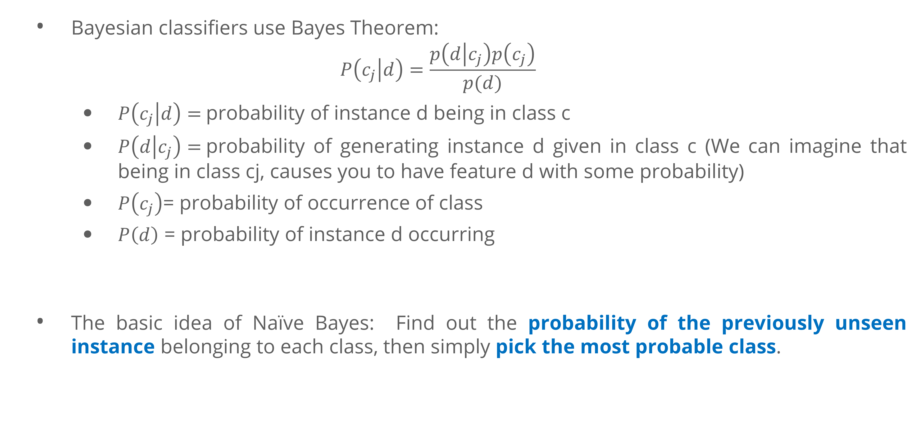
Bayes Classifier
Bayesian classifiers use Bayes Theorem:
$$P\left(c_{j} | d\right)=\frac{p\left(d | c_{j}\right)p\left(c_{j}\right)}{p(d)}$$
$P\left(c_{j} | d\right)=$probability of instance d being in class c
$P\left(d | c_{j}\right)=$probability of generating instance d given in class c (We can imagine that being in class cj, causes you to have feature d with some probability)
$P\left(c_{j}\right)$= probability of occurrence of class
$P\left(d\right)$ = probability of instance d occurring
The basic idea of Naïve Bayes: Find out the probability of the previously unseen instance belonging to each class, then simply pick the most probable class.

Slide 14
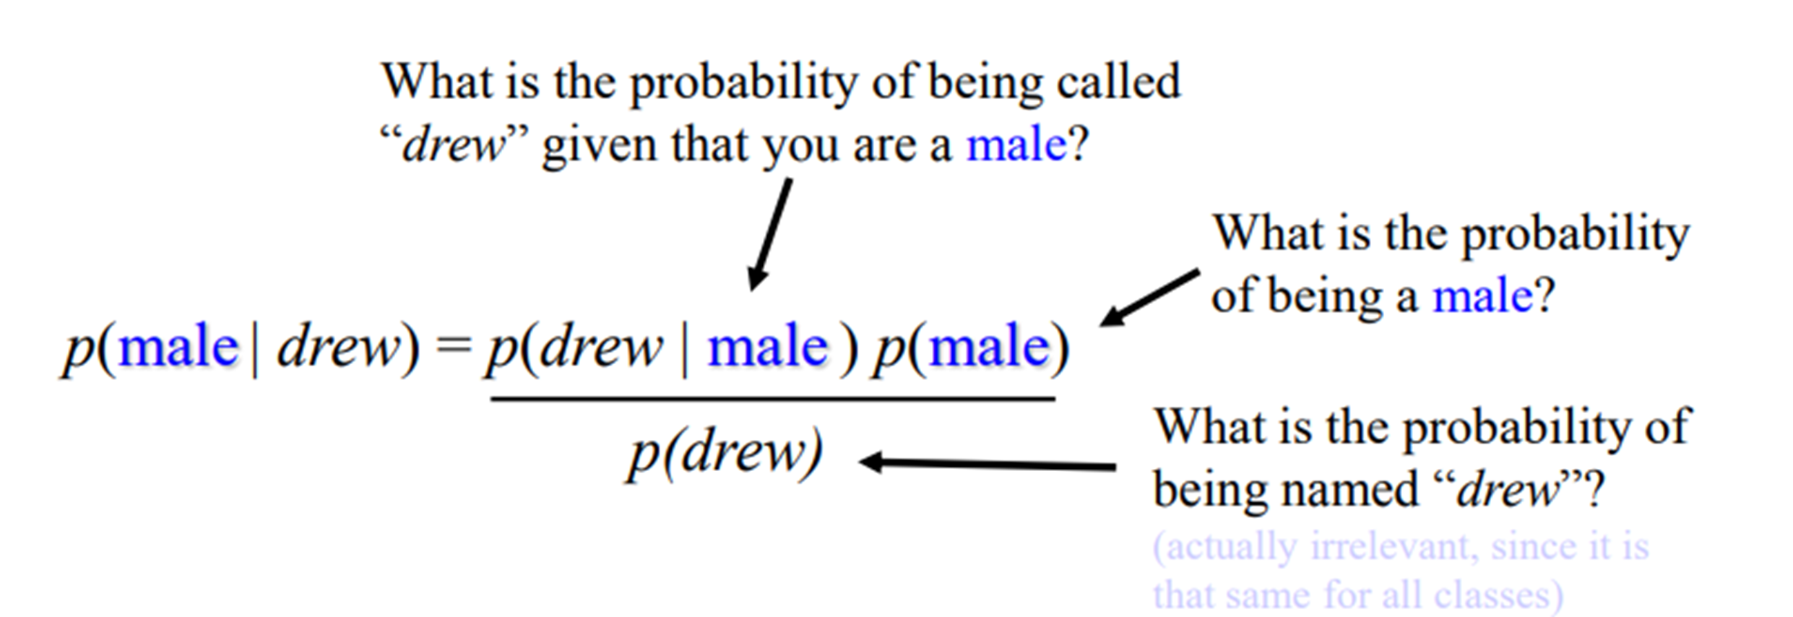
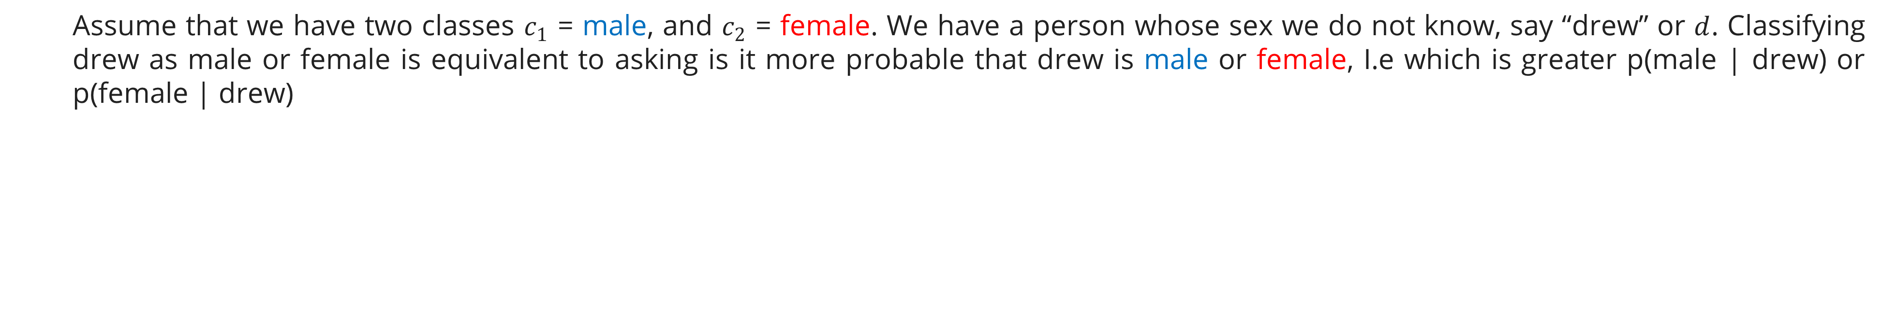
Bayes Classifier
Assume that we have two classes $c_{1}$ = male, and $c_{2}$ = female. We have a person whose sex we do not know, say “drew” or $d$. Classifying drew as male or female is equivalent to asking is it more probable that drew is male or female, I.e which is greater p(male | drew) or p(female | drew)

Slide 15

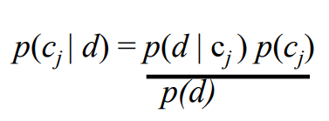
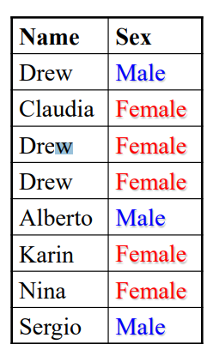
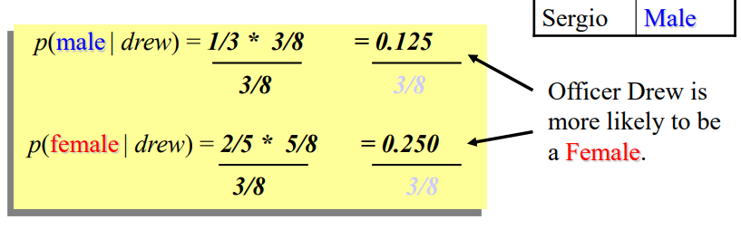
Bayes Classifier
This is Officer Drew (who arrested me in 1997). Is Officer Drew a Male or Female?
Luckily, we have a small database with names and sex

Slide 16
Bayes Classifier
So far we have only considered Bayes Classification when we have one. But we may have many features.
How do we use all the features?
To simplify the task, naïve Bayesian classifiers assume attributes have independent distributions, and thereby estimate

Slide 17
Bayes Classifier
Advantages Naïve Bayes:
Fast to train (single scan). Fast to classify
Not sensitive to irrelevant features
Handles real and discrete data
Handles streaming data well
Disadvantages Naïve Bayes:
Assumes independence of feature

Slide 18
Exercise

Slide 19
Exercise
You are a data scientist tasked with analyzing the Titanic dataset. The ultimate goal of your analysis is to build a model that can predict which passengers survived the Titanic disaster (https://www.kaggle.com/competitions/titanic). Your objective is to build a logistic regression model to predict the binary outcome of survival for the Titanic passengers.
Split the dataset into a training set and a testing set to evaluate your model's performance (70:30).
Develop a Naïve Bayes model using your selected features.
Evaluate the performance of your Naïve Bayes model using metrics such as accuracy, precision, recall, and the ROC-AUC score.
Provide a detailed analysis of the confusion matrix to understand the true positives, false positives, true negatives, and false negatives.

Slide 20
References

Slide 21
References
Bishop, C. M. (2016). Pattern Recognition and Machine Learning (Softcover reprint of the original 1st edition 2006 (corrected at 8th printing 2009)). Springer New York.
Dundar, M. (2013). Bayes Rule, Naïve Bayes, Bayesian Inference, Gaussian Partitions. CSCI 590: Machine Learning. https://cs.iupui.edu/~mdundar/CSCIMachineLearning/Lecture5.pdf
Keogh, E. (n.d.). Naïve Bayes Classifier. UCR Computational Entomology. Retrieved November 22, 2023, from https://www.cs.ucr.edu/~eamonn/CE/Bayesian%20Classification%20withInsect_examples.pdf
Ray, S. (2023). Naive Bayes Classifier Explained: Applications and Practice Problems of Naive Bayes Classifier. Analytics Vidhya. https://www.analyticsvidhya.com/blog/2017/09/naive-bayes-explained/

